Slide 1
Insights from 76 Climate Persuasion Tests With Jacob B. Rode & Caitlin N. Benedict Thursday, January 20th, 2022
Hosted by »»
Notes:
We’re just going to give it a few minutes to allow for some stragglers to join!
Alright, lets get started! My name’s Rebecca and I’m the Program Lead at the Lab. Also on the call is my Sean, our ED.
Before we get started, I just wanted to flag a few logistics. If at any point you have any questions about what we’re covering, feel free to drop it into the Chat box below. We try to make this presentation pretty interactive so if you have some thoughts and want to weigh in, feel free to unmute yourself to speak.
Since I’ll be leading the webinar and focusing on the presentation, Sean will be monitoring the chat and calling things out for me if necessary.
Alright? Cool!

Slide 2
Caitlin N. Benedict
Jacob B. Rode
linkedin.com/in/caitlinbenedict
jbenjaminrode@gmail.com
Notes:
Caitlin N. Benedict:
"I graduated from University of California Irvine with a Master's in Social Ecology in December 2021 where I studied climate change communication. I now have an Americorps fellowship with California Climate Action Corps where I work with the city government of San Jose on community engagement and outreach for their climate action plan."
Jacob B. Rode:
I received a PhD in social psychology from the University of California, Irvine. I am currently a postdoc at Harvard University, where I teach courses and conduct research. My research interests include motivated reasoning and partisan bias with a specific focus on environmental attitudes.

Slide 3
What we’ll cover today
Review of research on climate persuasion
Review of research on reducing political polarization on climate
Implications for the work of climate advocates

Slide 4
Influencing climate change attitudes: A systematic review and meta-analysis
Caitlin Benedict and Jacob Rode
Climate Advocacy Lab
January 20, 2022
Notes:
Jacob start

Slide 5
What influences people’s belief in climate change and support for policies to address it?

Slide 6
Example social science experiment

Slide 7
Messaging
“Pro”: others are willing to take action
“Con”: others are not willing to take action
Descriptive social norm message:
A recent poll showed that over 85% of Americans believe that the world’s average temperature is rising primarily because of human activities. In addition, the vast majority of respondents said they would consider driving smaller cars, reducing travel, and supporting legislation (e.g., a tax) to reduce the nation’s emission of greenhouse gases.
Descriptive social norm message:
A recent poll showed that less than 15% of Americans believe that the world’s average temperature is rising primarily because of human activities. In addition, only a small minority of respondents said they would consider driving smaller cars, reducing travel, and supporting legislation (e.g., a tax) to reduce the nation’s emission of greenhouse gases.
Descriptive social norm message + injunctive social norm message:
…Respondents said the main reason they are unwilling to take these actions is because reducing our standards of living is the “wrong thing to do.”
Descriptive social norm message + injunctive social norm message:
…Respondents said the most important reason for taking these actions is because it is “the right thing to do for all of us.”
Bolson et al., 2014
Notes:
They hypothesized that pro norms would increase belief and policy support, and con norms would decrease them

Slide 8
Control
(no message)
Pro: Descriptive
social norm
Outcomes:
Belief in climate change
Belief that climate change is human-caused
Support for a carbon emissions cap
Pro: Descriptive
social norm + injunctive
Con: Descriptive
social norm
Con: Descriptive
social norm + injunctive

Slide 9
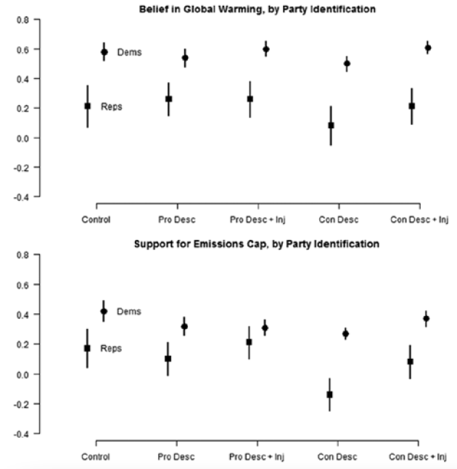
Effectiveness:
Difference in outcomes between treatment and control
More effective: higher average score in treatment than control
Less effective: lower average score in treatment than control

Slide 10
Common types of interventions

Slide 11
Experimental Interventions
Morality (e.g., Feinberg & Willer, 2013)
Health (e.g., Levine & Kline, 2017)
Economy (e.g., Dixon et al., 2017)
Scientific consensus (e.g., van der Linden et al., 2015)
Emotion (e.g., Skurka et al., 2018)
Policy manipulations (e.g., Campbell & Kay, 2014)

Slide 12
Morality
Humans are harming the environment and we need to care for it
The environment has become polluted and contaminated and we need to clean and purify it
Feinberg & Willer, 2013

Slide 13
Health
“…combating climate change would improve health through pollution reduction…” - Bernauer & McGrath, 2016, p. 681

Slide 14
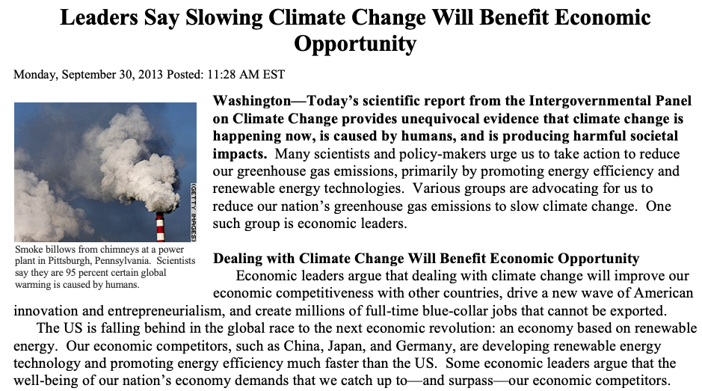
Economy
McCright et al., 2016

Slide 15
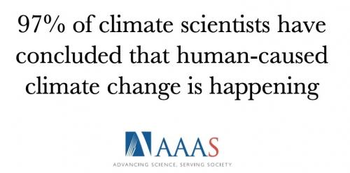
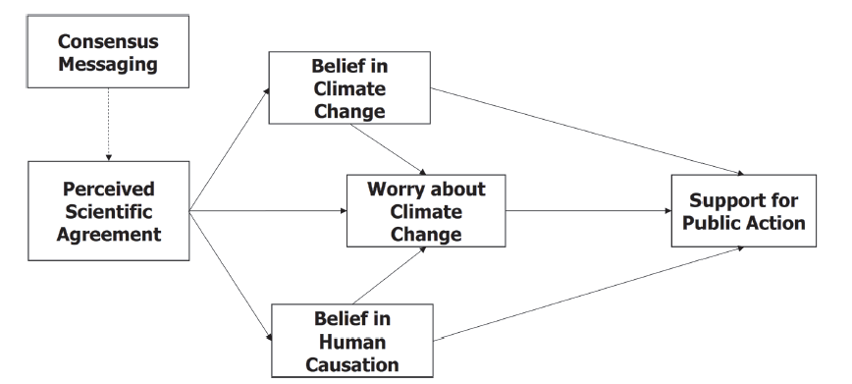
Scientific Consensus
van der Linden et al., 2015

Slide 16
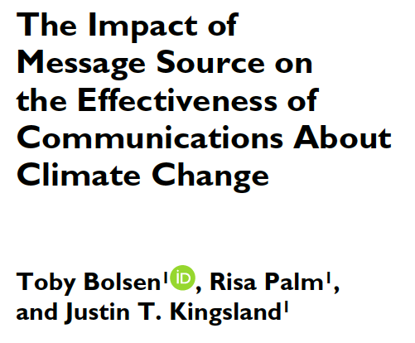
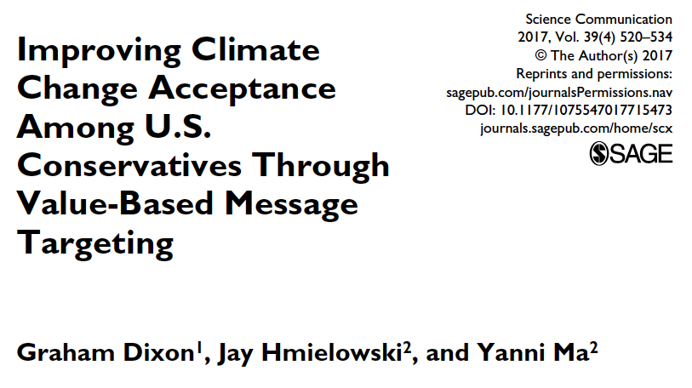
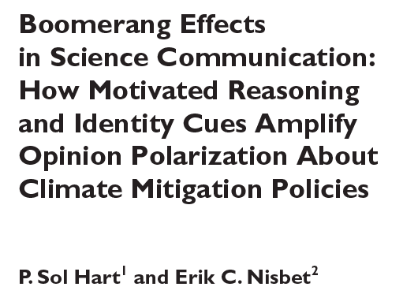
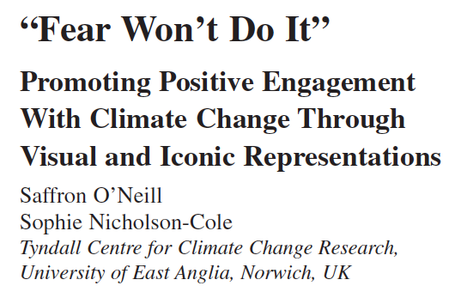
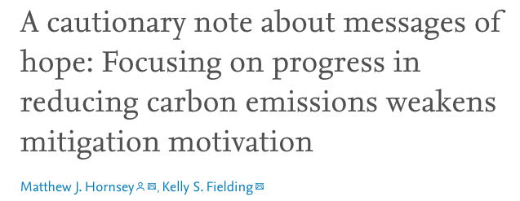
Mixed Findings

Slide 17
Debates

Slide 18
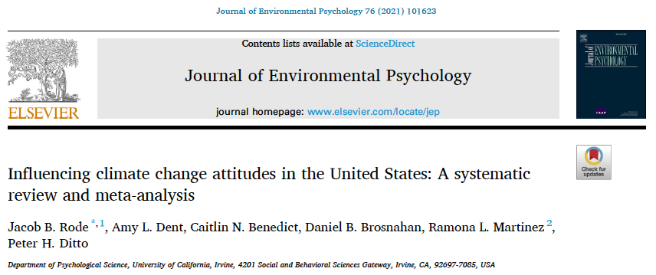

Slide 19
What is a meta-analysis and why do one?
Quantitative synthesis of a wide range of interventions
Clarify claims from single studies

Slide 20
Meta-Analysis Overview
Treatment – Control
Intervention type
Outcome type
Experiment 1
0.30
Morality
Worry about CC
Experiment 2
0.04
Social norms
Belief CC happening
Experiment 3
-0.10
Economic
Policy support
Total
0.08
Does effectiveness depend on moderators, such as intervention or outcome type?
Summary/overall effect

Slide 21
Methods
Searched:
Web of Science (N = 11,311)
PsycINFO (N = 1,574)
Communications Abstracts (N = 243)
Additional papers (N = 26)
Retrieved data from:
63 individual reports
76 independent experiments
396 effect sizes
905 effect sizes when split by political ideology
N = 76,033 total participants
Notes:
75 selected reports (58 emailed)

Slide 22
Inclusion and Exclusion Criteria
Inclusion:
Experimental studies (i.e., random assignment)
Control condition
Climate change attitudes
Exclusion:
Non-US participants
Participants under 18 years old

Slide 23
Moderators
Moderators
Political group
Intervention type
Outcome type

Slide 24
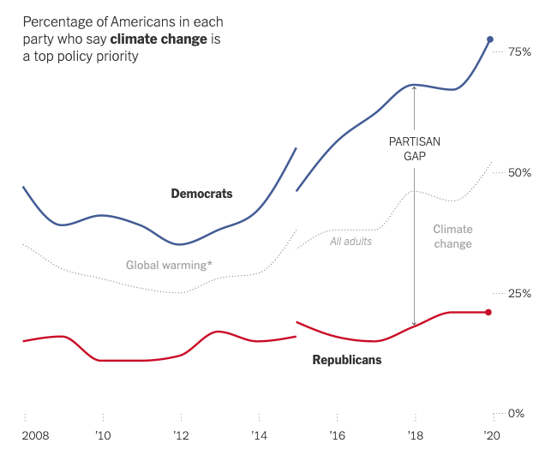
Partisan Divide on Climate Change
Increasing divide between partisans about climate change as a phenomenon and its importance (McCright & Dunlap, 2011)
Politics is the biggest driver of attitudes towards climate change (Hornsey et al., 2016)
Popovich, 2020

Slide 25
Moderators
Moderators
Political group
Intervention type
Hypotheses
Smaller effects for conservatives
Largest effects: National security, Economic, Psychological distance (near)

Slide 26
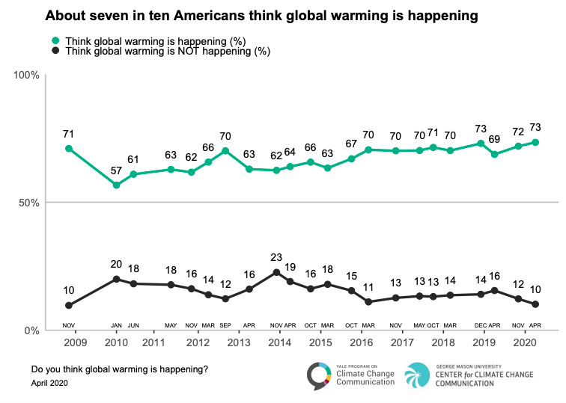
Leiserowitz et al., 2020

Slide 27
Moderators
Moderators
Political group
Intervention type
Outcome type
Hypotheses
Smaller effects for conservatives
Largest effects: National security, Economic, Psychological distance (near)
Larger effect for belief than other attitudes
Notes:
Belief more malleable

Slide 28
Moderators
Additional moderator that emerged: negative interventions
Examples:
Misinformation (e.g., “Polar ice caps are at an all time high”)
Anti-climate change argument (e.g., “Mitigating climate change will destroy the economy”)
Earlier example: “Con” social norms (e.g., others aren’t taking action)

Slide 29
Intervention direction
Positive: interventions intended to increase attitudes
Mixed: interventions with both positive and negative manipulations
(e.g., misinformation and debunking)
Negative: interventions intended to decrease attitudes

Slide 30
Results

Slide 31
Intervention Direction

Slide 32
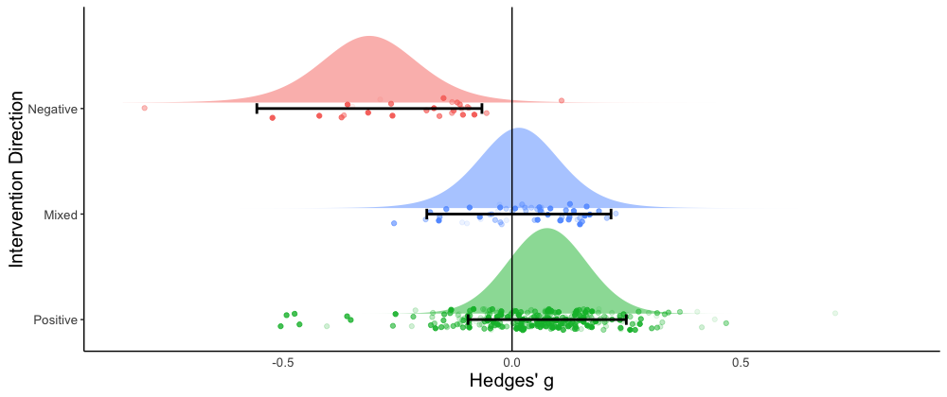
The rest of the analyses only included positive interventions
g = -0.29
g = 0.01
g = 0.08
Error bars are 95% prediction intervals

Slide 33
Summary effect
Overall, a very small, statistically significant, and positive effect:
g = 0.08, 95% CI [0.05, 0.10],
95% prediction interval [-0.04, 0.19],
p < .001
Error bars are 95% prediction intervals
Notes:
Sig moderator. Sig difference between pos and neg, but not sig between neg and mixed

Slide 34
Which type of intervention is most effective?

Slide 35
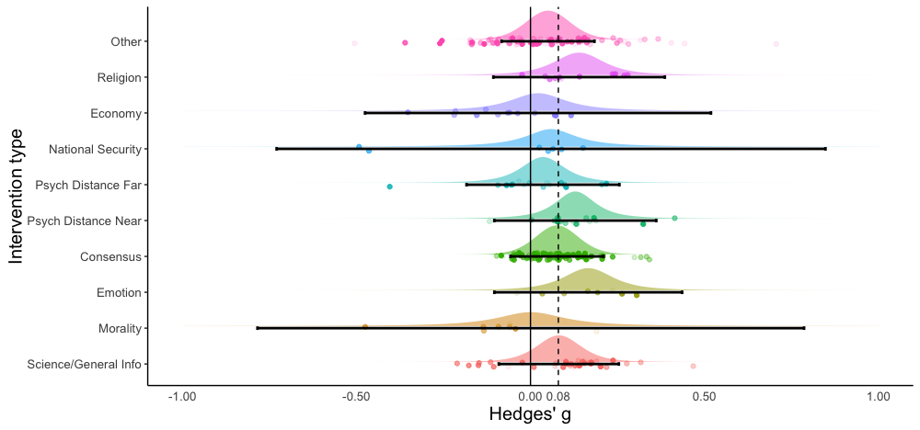
No clear “best” intervention (few independent samples of each type)
n = 32, k = 101
n = 4, k = 14
n = 4, k = 13
n = 3, k = 7
n = 5, k = 16
n = 6, k = 18
n = 20, k = 89
n = 4, k = 8
n = 3, k = 8
n = 11, k = 38
Notes:
N = number of independent samples
K = number of effect sizes

Slide 36
Are interventions more effective for liberals, conservatives, or moderates?

Slide 37
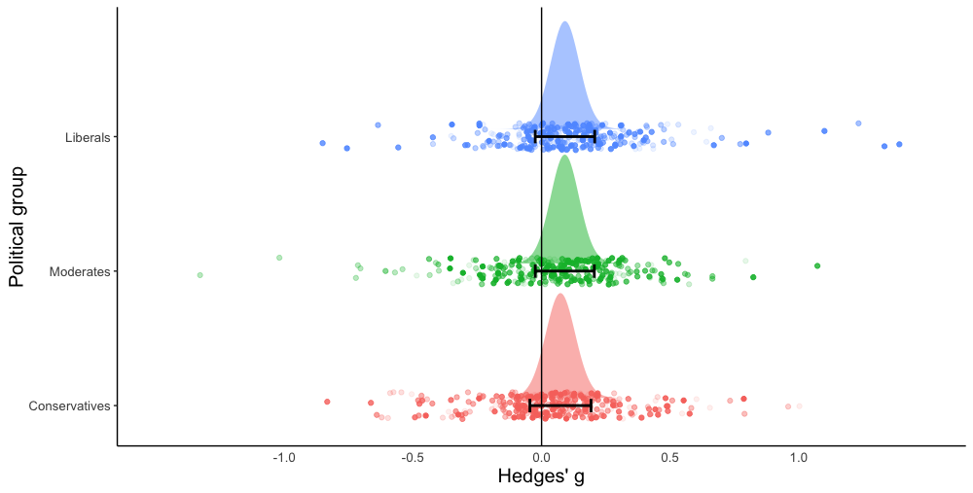
Not a significant moderator of effect size

Slide 38
Which type of attitude is easiest to influence?

Slide 39
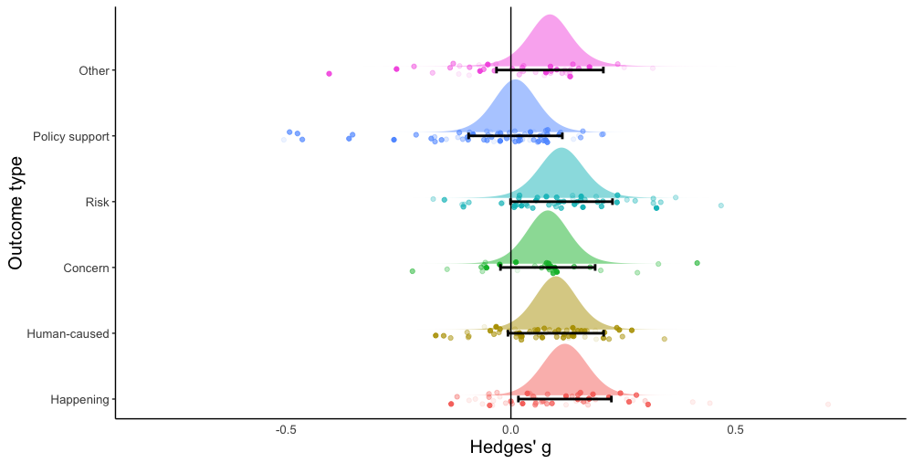
Policy support significantly smaller than all others
g = 0.09
g = 0.01
g = 0.11
g = 0.08
g = 0.10
g = 0.12

Slide 40
While many other moderators were tested…. most moderators – and interactions with politics –
were nonsignificant

Slide 41
Takeaways
Climate change attitudes are resistant to change
Wide variety of interventions
Skepticism may come easier than belief and action
Asymmetry: successful interventions may need to be particularly tailored, whereas general negative information may spark skepticism
Policy support is difficult to influence
Other determinants of policy support beyond climate attitudes

Slide 42
A note of caution:
Aggregating across many studies can mask the strengths of primary experiments
All studies were conducted in 2019 or earlier
Only included experiments with a control condition
Some promising interventions not included

Slide 43
Implications for climate change communication

Slide 44
What is an impactful effect size?
Find different interventions? Move past tiny effects?
Over time and/or across people, very small effects can be meaningful
With entrenched attitudes such as these, anything is helpful
Repeated messaging interventions could have a larger effect than one-time messaging

Slide 45
Review chapter on political polarization
Narrative review of similar interventions, focusing on those most likely to reduce political polarization over climate change
Highlights the mixed nature of findings
Some promising interventions:
Conservative sources attached to specific climate change policies
Moral reframing (though more research is needed)
The more targeted, the better
Rode & Ditto, 2021
Notes:
Narrative review expands the population of studies compared to quantitative (eg don’t need control condition)

Slide 46
Future Directions
More targeted interventions (e.g., Goldberg et al., 2021)
Investigating policy attitudes
Other routes to support besides climate change? Where are there areas of agreement?

Slide 47
Thank you!
Authors:
Jacob Rode
Amy Dent
Caitlin Benedict
Danny Brosnahan
Ramona Martinez
Peter Ditto

Slide 48
References
Bernauer, T., & McGrath, L. F. (2016). Simple reframing unlikely to boost public support for climate policy. Nature Climate Change, 6(7), 680–683. https://doi.org/10.1038/nclimate2948
Bolsen, T., Leeper, T. J., & Shapiro, M. A. (2014). Doing what others do: Norms, science, and collective action on global warming. American Politics Research, 42(1), 65–89. https://doi.org/10.1177/1532673X13484173
Campbell, T. H., & Kay, A. C. (2014). Solution aversion: On the relation between ideology and motivated disbelief. Journal of Personality and Social Psychology, 107(5), 809–824. https://doi.org/10.1037/a0037963
Dixon, G., Hmielowski, J., & Ma, Y. (2017). Improving climate change acceptance among U.S. conservatives through value-based message targeting. Science Communication, 39(4), 520–534. https://doi.org/10.1177/1075547017715473
Feinberg, M., & Willer, R. (2013). The moral roots of environmental attitudes. Psychological Science, 24(1), 56–62. https://doi.org/10.1177/0956797612449177
Goldberg, M. H., Gustafson, A., Rosenthal, S. A., & Leiserowitz, A. (2021). Shifting Republican views on climate change through targeted advertising. Nature Climate Change, 11, 573–577. https://doi.org/10.1038/s41558-021-01070-1
Hornsey, M. J., Harris, E. A., Bain, P. G., & Fielding, K. S. (2016). Meta-analyses of the determinants and outcomes of belief in climate change. Nature Climate Change, 6, 622–626. https://doi.org/10.1038/nclimate2943

Slide 49
References
Leiserowitz, A., Maibach, E., Rosenthal, S., Kotcher, J., Bergquist, P., Ballew, M., Goldberg, M., Gustafson, A., & Wang, X. (2020). Climate change in the American mind: April, 2020. New Haven, CT: Yale Project on Climate Change Communication. https://climatecommunication.yale.edu/publications/climate-change-in-the-american-mind-april-2020/
Levine, A. S., & Kline, R. (2017). A new approach for evaluating climate change communication. Climatic Change, 142, 301–309. https://doi.org/10.1007/s10584-017-1952-x
McCright, A. M., Charters, M., Dentzman, K., & Dietz, T. (2016). Examining the effectiveness of climate change frames in the face of a climate change denial counter-frame. Topics in Cognitive Science, 8(1), 76–97. https://doi.org/10.1111/tops.12171
McCright, A. M., & Dunlap, R. E. (2011). The politicization of climate change and polarization in the American public’s views of global warming, 2001–2010. The Sociological Quarterly, 52(2), 155–194. https://doi.org/10.1111/j.1533-8525.2011.01198.x
Popovich, N. (2020, February 20). Climate change rises as a public priority. But it’s more partisan than ever. The New York Times. Retrieved from https://www.nytimes.com/interactive/2020/02/20/climate/climate-change-polls.html

Slide 50
References
Rode, J. B., & Ditto, P. H. (2021). Can the partisan divide in climate change attitudes be bridged? A review of experimental interventions. In J.-W. van Prooijen (Ed.), The Psychology of Political Polarization (1st ed., pp. 149–168). Routledge. https://doi.org/10.4324/9781003042433
Skurka, C., Niederdeppe, J., Romero-Canyas, R., & Acup, D. (2018). Pathways of influence in emotional appeals: Benefits and tradeoffs of using fear or humor to promote climate change-related intentions and risk perceptions. Journal of Communication, 68(1), 169–193. https://doi.org/10.1093/joc/jqx008
van der Linden, S. L., Leiserowitz, A. A., Feinberg, G. D., & Maibach, E. W. (2015). The scientific consensus on climate change as a gateway belief: Experimental evidence. PLoS ONE, 10(2), e0118489. https://doi.org/10.1371/journal.pone.0118489

Slide 51
Some of Justin’s take-aways
Persuasion works!
But you should expect small effects
Test. Test. Test.
Policy support is hard
Still target and tailor
Target both sides of the aisle
Men have hard heads
Mostly white data
Don’t forget our other tools in the toolbox
Organizing the future
No silver bullet
Notes:
Persuasion works!
Small, but not zero effects
changing the mind of only one out of 43 people seeing a message.
this can’t ever be taken for granted
Other reviews of political advertising and contact have found small effects, or in some circumstances NO effect.
But you should expect small effects
Take-away from this research should not be “persuasion can’t be done’
But rather…
Our prior should be small effects
Based on 10,000
“persuasion needs to be carefully designed and tested”
No silver bullet
No message strategy was clear winner in either study
Test. Test. Test.
Backfire effects are real
Cited often in polarization paper
Importance of testing first (with a control) when trying persuasion
Policy support is hard
Beliefs easier to change than policy attitudes
Mostly white data
available studies were with participant pools that ranged (with two exceptions) from 60%–90% white (averaging 74% white).
No message buckets were particularly oriented towards those of color or focused on climate justice.
Good message testing with Black/Latinx folks
WE ACT for Environmental Justice + GreenLatinos + Third Way
Future generations & jobs worked; “climate justice” didn’t do well
Men have hard heads
Still target and tailor
There wasn’t enough data to look at subgroup analysis
But other research says targeting messages is good
Rarely do practitioners want to target/persuade ‘all Americans’
Targeting models, for instance, can find more persuadable people
Target both sides of the aisle
The review found people are equally persuadable across the political spectrum, from Democrats to Republicans
Don’t forget our other tools in the toolbox
Quality of intervention may matter
Intervention type buckets from Rode et al papers combined high & low quality interventions
But varying quality might explain mixed results
Few interventions were strong
Deep canvass, relational conversation, cultural strategy, multiple exposures
Lab just did guide on relational climate conversations
Organizing the future
Would like to see similar reviews of mobilizing/organizing interventions
If persuasion is hard, alternative to grow power is growing and and turning out your base

Slide 52
Breakout in pairs
“What is one thing you learned today that you will want to apply in your work (and how)?”
One person shares for a couple minutes, then switch to the other person

Slide 53
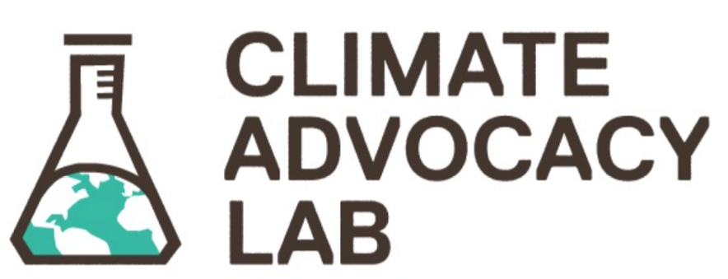
Justin Rolfe-Redding
justin@ClimateAdvocacyLab.org
Invite others to apply for Lab membership
ClimateAdvocacyLab.org
/become-a-member

