Slide 1
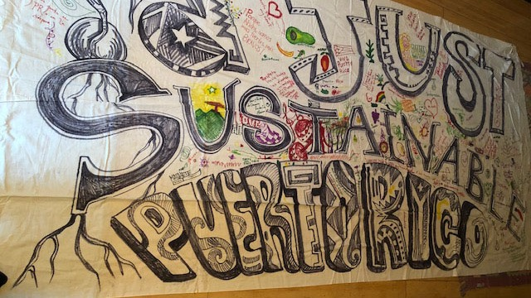
Our Power Puerto Rico
Please introduce yourself in the chat box with your Name, Location, and Organization/Affiliation
A campaign case study & framework for Just Recovery
December 11, 2019
Image: Just Sustainable Puerto Rico participatory banner created at the welcome event for the Greenpeace boat in San Juan, November 2017. Photo by Crystal Clarity.

Slide 2
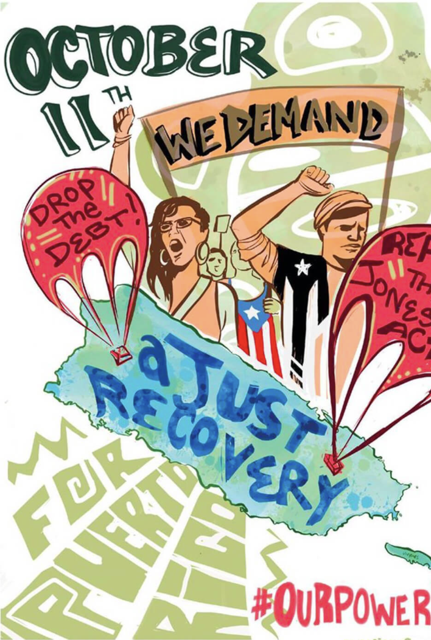
Trailmap
Please introduce yourself in the chat box with your Name, Location, and Organization/Affiliation
Opening & Welcome––from the Lab (Lucía) & CJA (Angela)
An introduction to “Just Recovery”––Jayeesha Dutta
Just Recover response in PR––Jesús Vázquez
Solidarity brigades & process ––Shakara Tyler
Our Power PR Campaign––Elizabeth Yeampierre
Q&A
Closing
Image created by Crystal Clarity

Slide 3
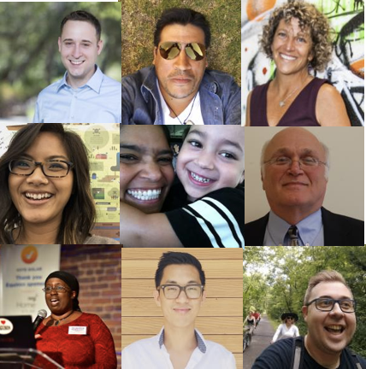
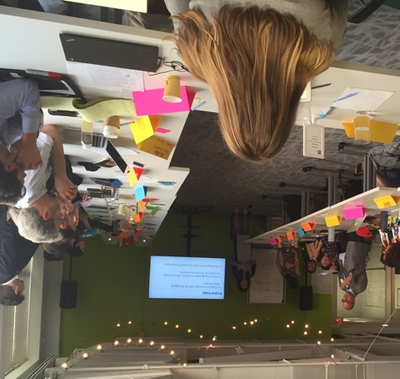
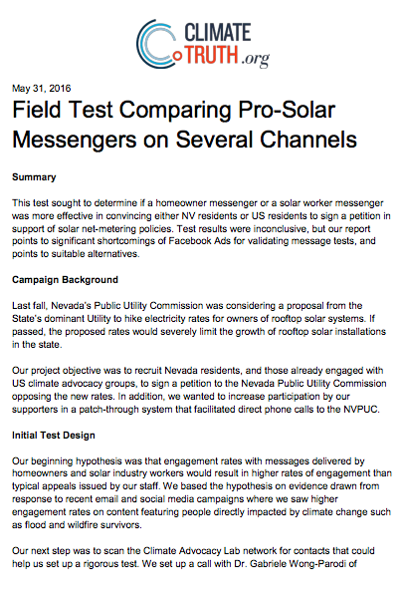
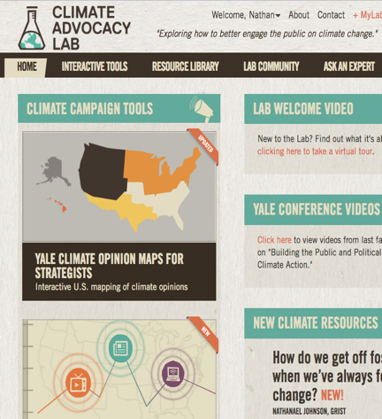
The Climate Advocacy Lab
Our (awesome!) members
Workshops & Webinars
Research
Online platform
Helping the climate community build grassroots power and win through evidence-based advocacy.

Slide 4
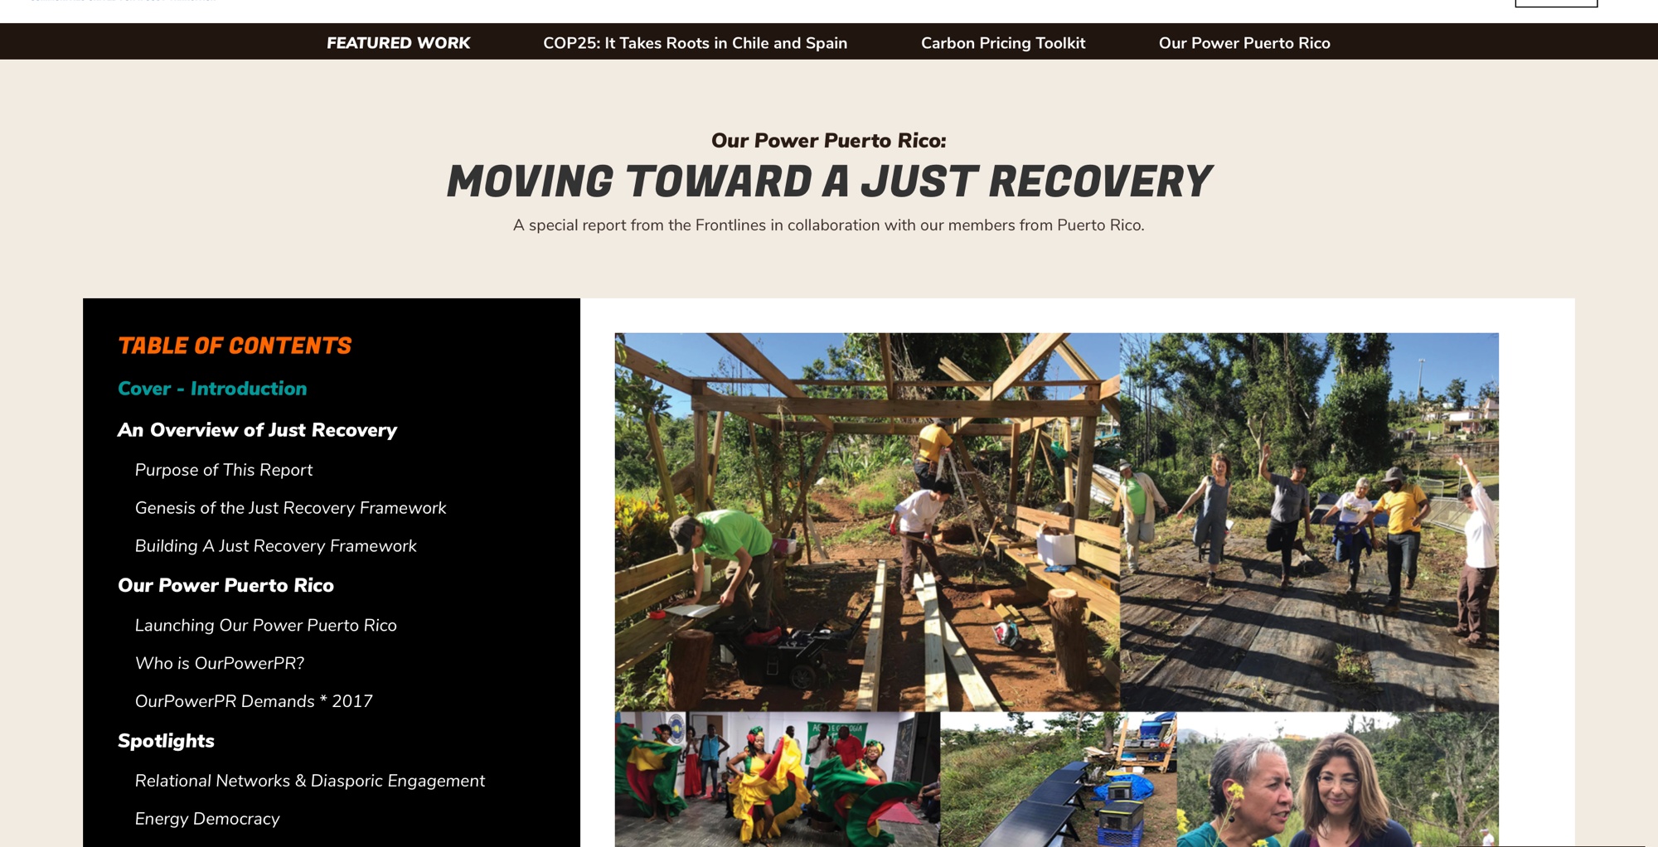

Slide 5
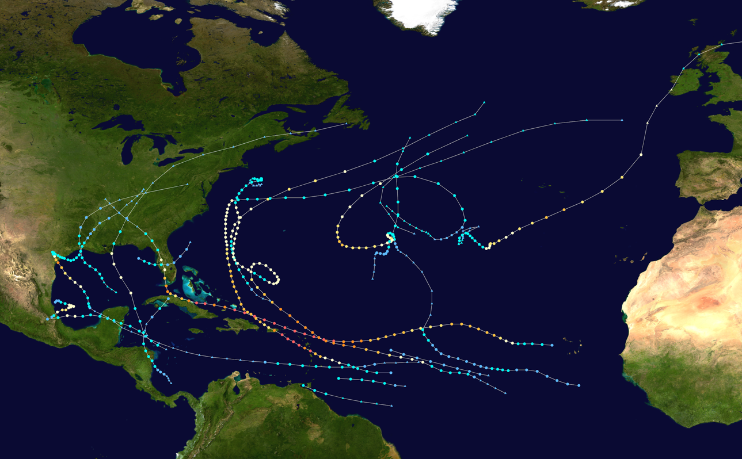
GENESIS OF THE TERM “JUST RECOVERY”
2017 Atlantic/Gulf/Caribbean Hurricane Season

Slide 6
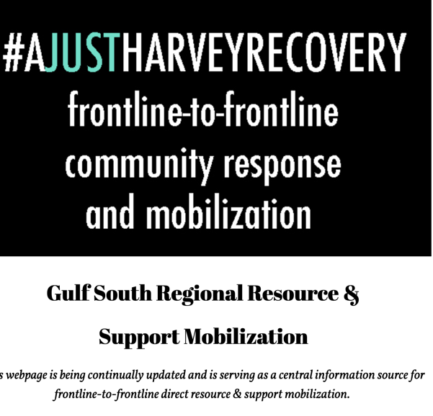
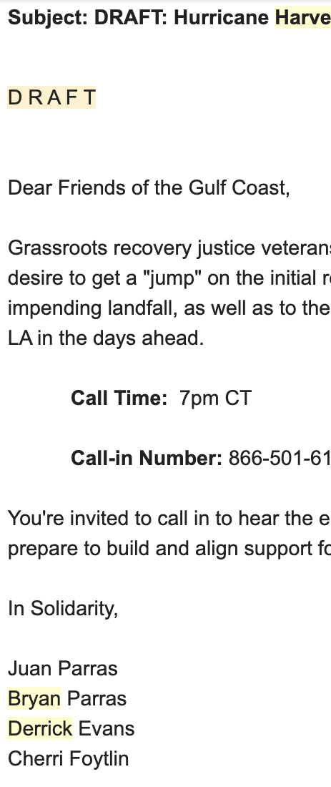
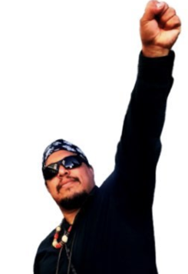
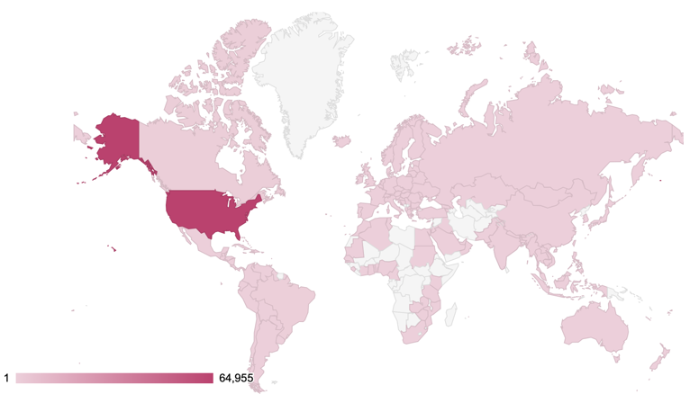
AUGUST 25-27, 2017
HURRICANE HARVEY - HOUSTON

Slide 7
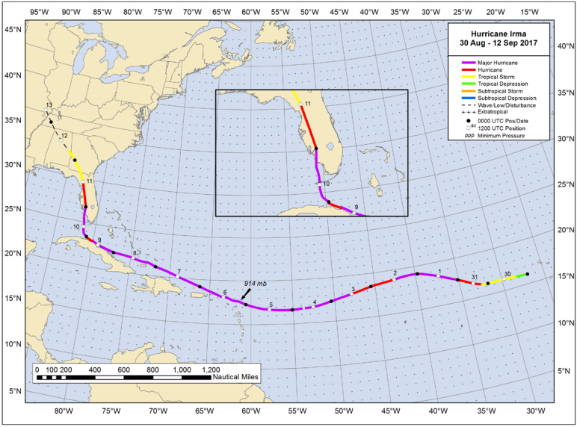
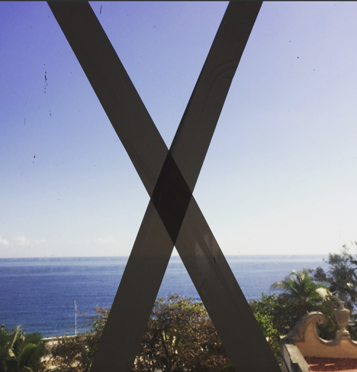
SEPTEMBER 8-9, 2017
HURRICANE IRMA - CUBA

Slide 8
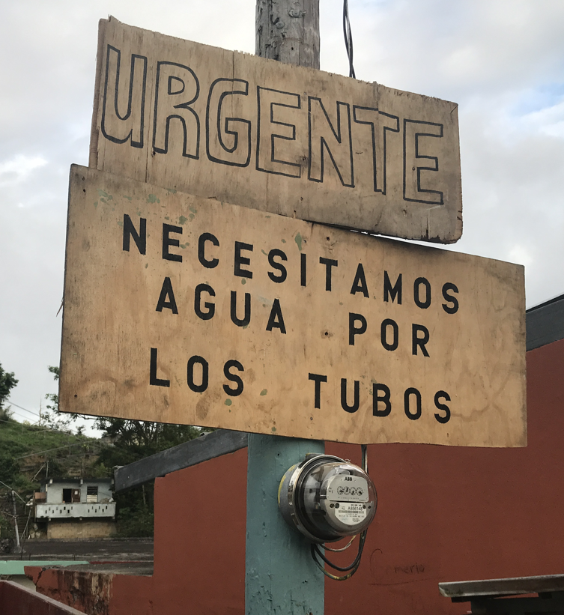
SEPTEMBER 20, 2017
HURRICANE MARIA - PUERTO RICO

Slide 9
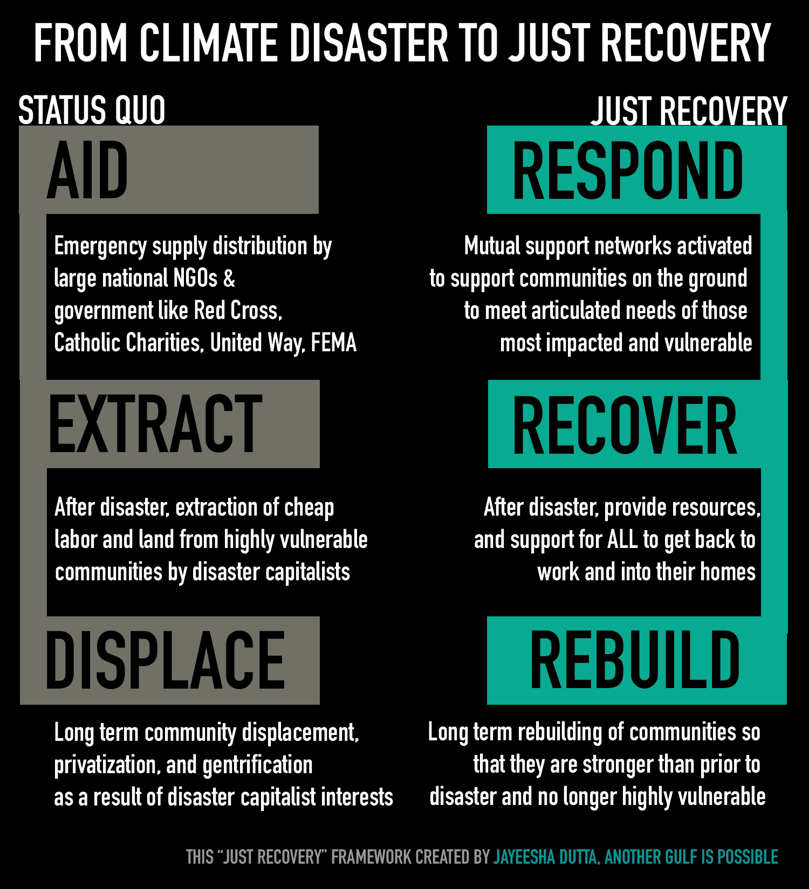

Slide 10
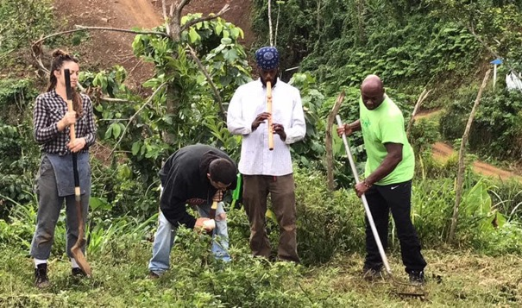
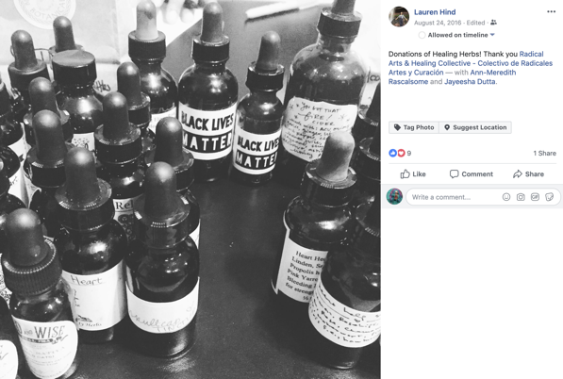
Community-accountable artists are often trusted in their neighborhoods, and naturally provide their time, space, energies, talents, and connections in moments of disaster. Even beyond the role of ART itself in a moment of disaster to heal and unify, other “tangible” disaster response and recovery assets exist, for example where cultural centers can act as disaster response centers and supply distribution points.
JUST RECOVERY STRATEGY: ART SAVES LIVES, SO VALUE COMMUNITY ACCOUNTABLE ARTISTS NOW
During times of disaster, community artists often play first & secondary responder roles, so, resource them now.
artists as first responders
ART SAVES LIVES
Invest in artists disaster funds and fellowships to promote culture and community, positioning artists and cultural spaces to be trusted “first and secondary responders” to disaster recovery and rebuild processes.
Train artists to be disaster resource managers, and in emergency rescue protocols. Many artists are connected to a lot of folks in their communities and can quickly disseminate knowledge, resources, ideas, materials, and supplies.

Slide 11
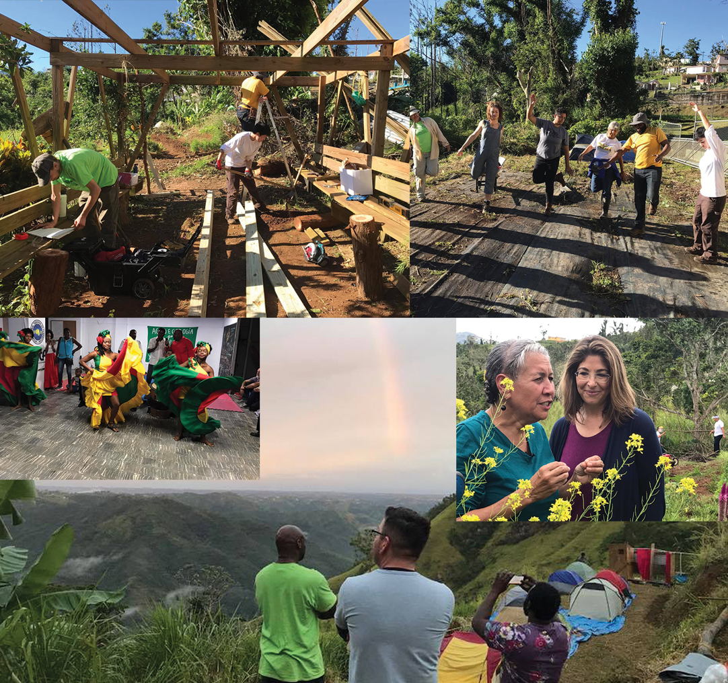
OUR POWER PUERTO RICO

Slide 12
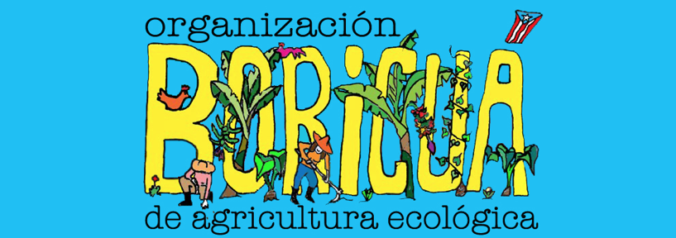
A national platform with 30 years of history composed by farmers, “jíbaros”/ peasants, farm workers and food sovereignty activists from rural, coastal and urban communities.
Organización Boricuá is a decentralized organization with a multiregional, intergenerational and diverse membership that holds a network of agroecological farms and educational projects in Puerto Rico.
The organization promotes and practices agroecology as a vehicle to achieve food sovereignty and social justice.
Has presence in all of the regions of the country and is part of the international movement of the Latin American Coordinator of Peasant Organizations, La Vía Campesina and the Climate Justice Alliance.
.

Slide 13
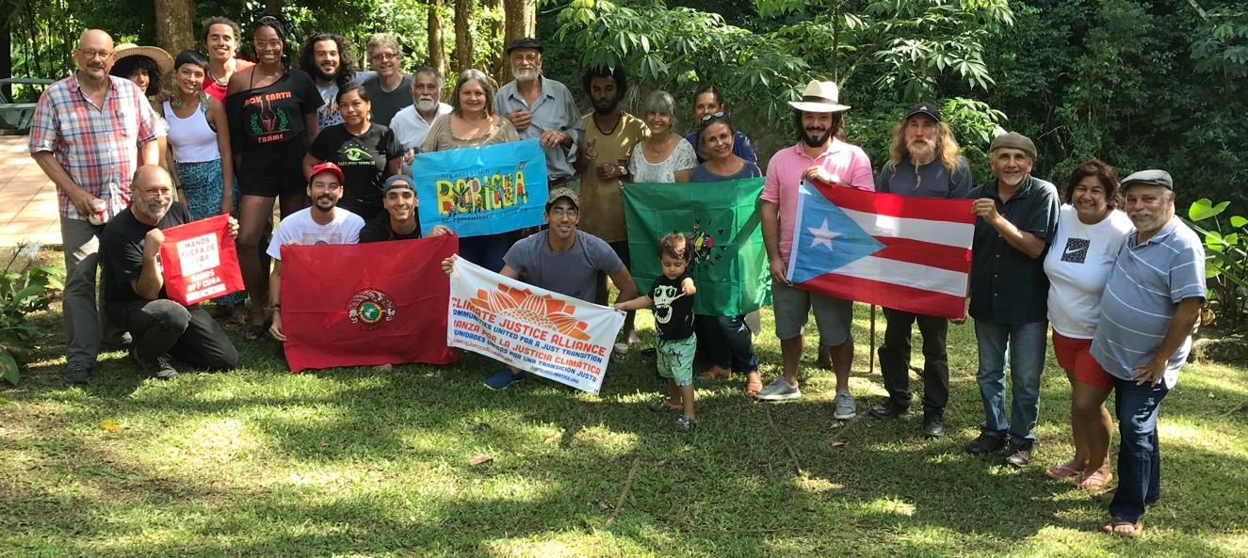

Slide 14
Context and History: Puerto Rico
Before 1493: Taínos (indigenous) lived in Puerto Rico.
1493: Christopher Columbus arrives; Spanish colonization starts.
1868: Grito de Lares, insurrection.
1898: United States invaded Puerto Rico through the south.
1920: Jones Act, Merchant Marine Act
1952: Puerto Rico becomes a Commonwealth (Estado Libre Asociado).
1960: Agent Orange experiments and tests in Puerto Rico.

Slide 15
1960: Agent Orange experiments and tests in Puerto Rico.
2004: Genetically Modified Crops experimentation in Puerto Rico.
2016: Promesa Bill
2017: Hurricane Irma & María
2019: Governor Ricardo Roselló and his team resigns after big mobilizations and strikes by the people of Puerto Rico.

Slide 16
Importation of food to Puerto Rico

Slide 17
Local consumption of food based on place of origin

Slide 18
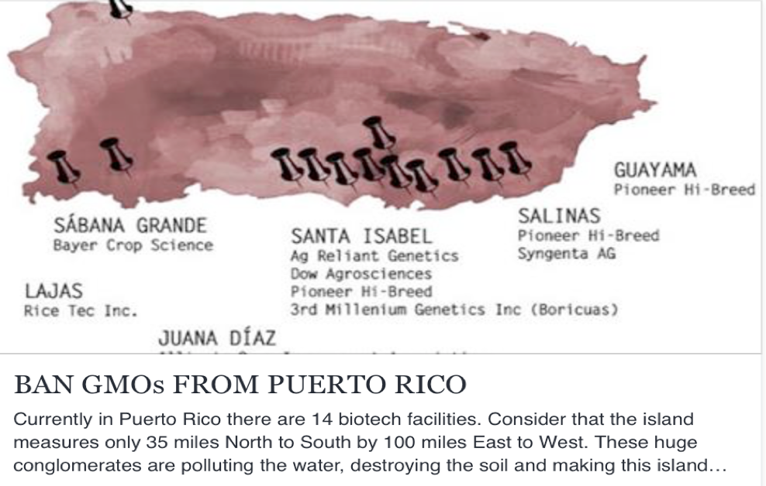
GMO Local Context
*Constitutional limit of 500 Acres.
*More than $512 million in incentives

Slide 19
Food Sovereignty
Food sovereignty is the fundamental right of all peoples, nations and states to control food, agricultural systems and policies, ensuring everyone has adequate, affordable, nutritious and culturally appropriate food. It is the right of the people (not multinational corporations) to define and control our methods of production, transformation, distribution both at the local and international levels.

Slide 20
Agroecology
Peasant agriculture, artisanal fisheries and herding remain the source of most of our food. Peasant agroecology is a social and ecological system encompassing a great diversity of technologies and practices that are culturally and geographically rooted. It removes dependencies on agro-toxins, reject confined industrial animal production, uses renewable energies, and guarantees healthy food. It enhances dignity, honours traditional knowledge and restores the health and integrity of the land. Food production in the future must be based on a growing number of people producing food in more resilient and diverse ways.

Slide 21
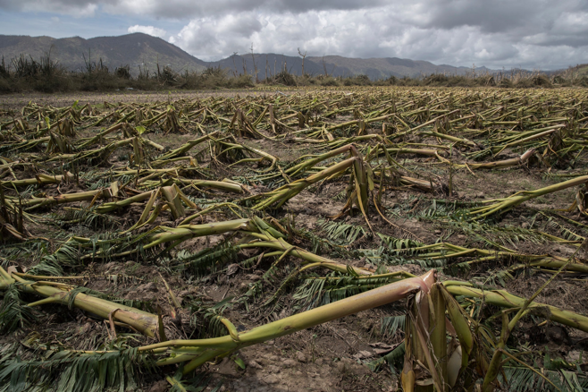
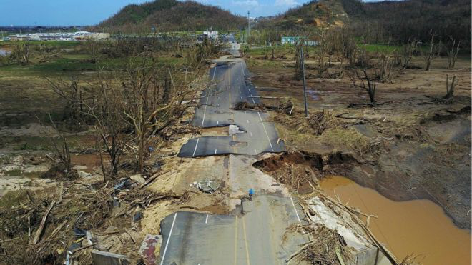
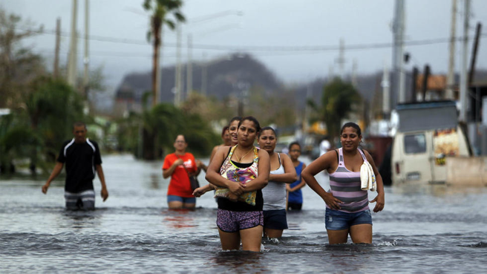
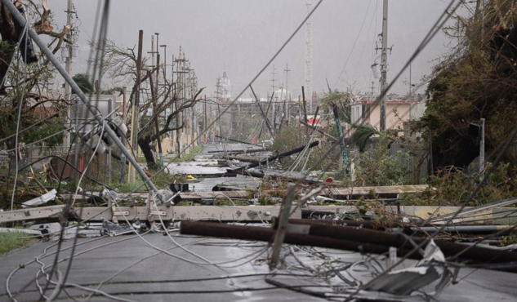
Hurricane María

Slide 22
Context
No access to electricity, communication, water and other basic necessities.
US Military presence.
80-90% of agricultural activity gone.
Death and “desaparecidos” rates keep rising. Officially, the government started saying only 51 deaths. News outlets and researches are reporting around 3,000 deaths are related to the Hurricane and its impacts.
Emigration: ~55,000 people have left the island.

Slide 23
Brigades: Heart of the Movement
Practical methodology used to educate, organize and massify agroecology through political formation, technical education and cultural expression through a Peasant to Peasant process.
Open space for public to participate and support.
Get to know a local farm.
Learn from a workshop – capacity building.
Share culture, food and get involved in your community.
Mutual Support for new and existing farmers.

Slide 24
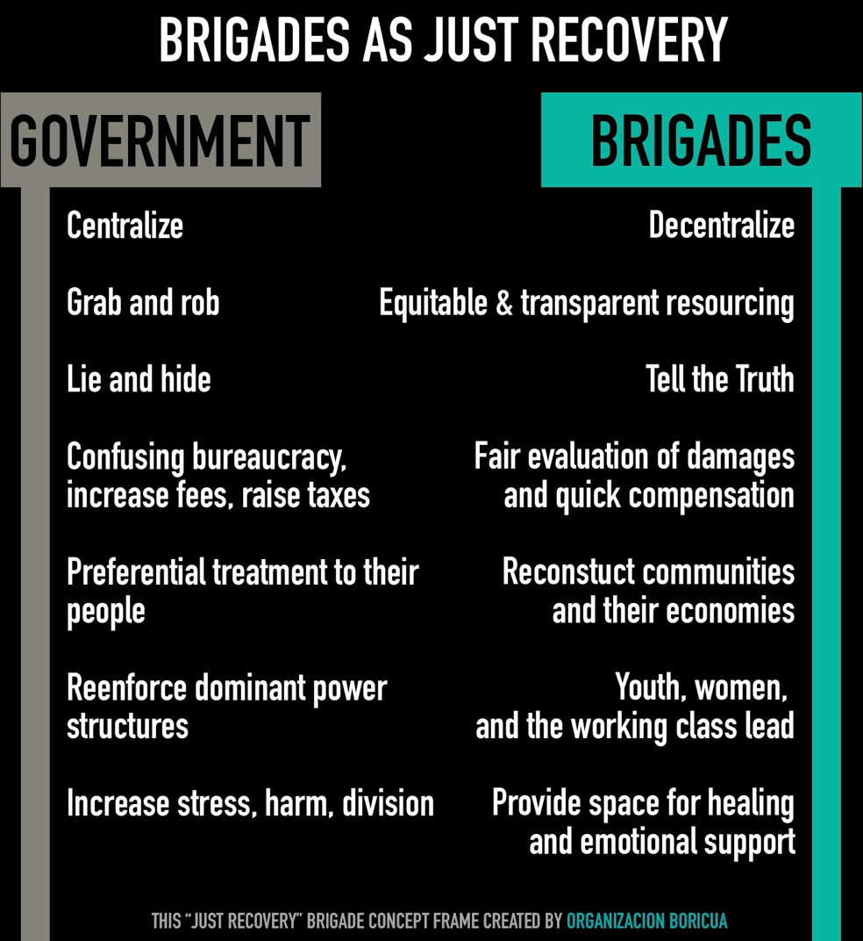

Slide 25
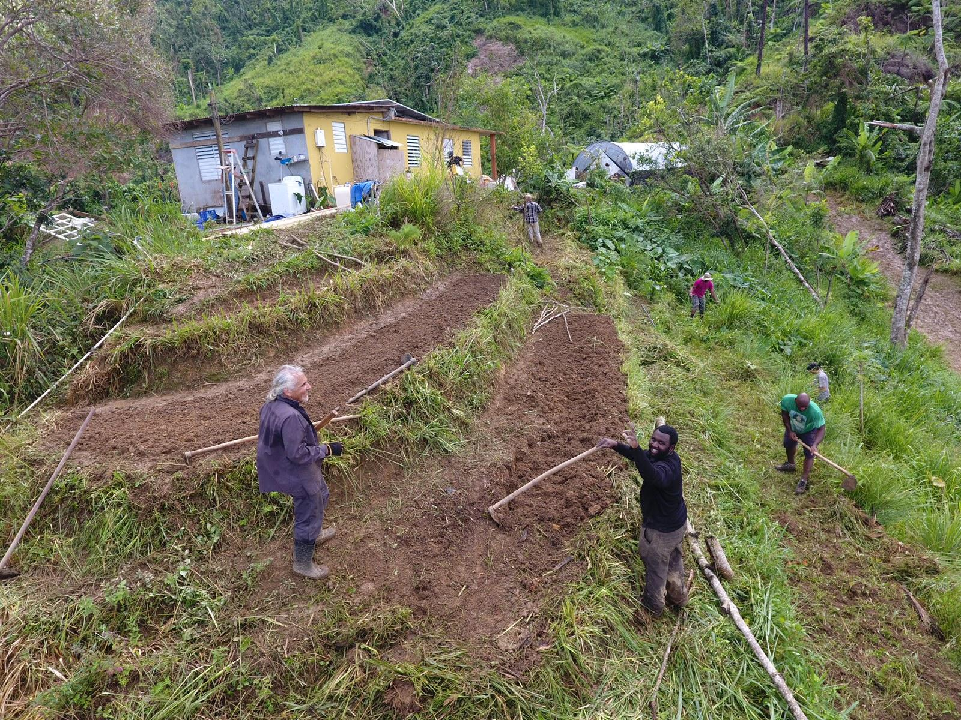
Finca La Jungla, Pellejas 1, Orocovis

Slide 26
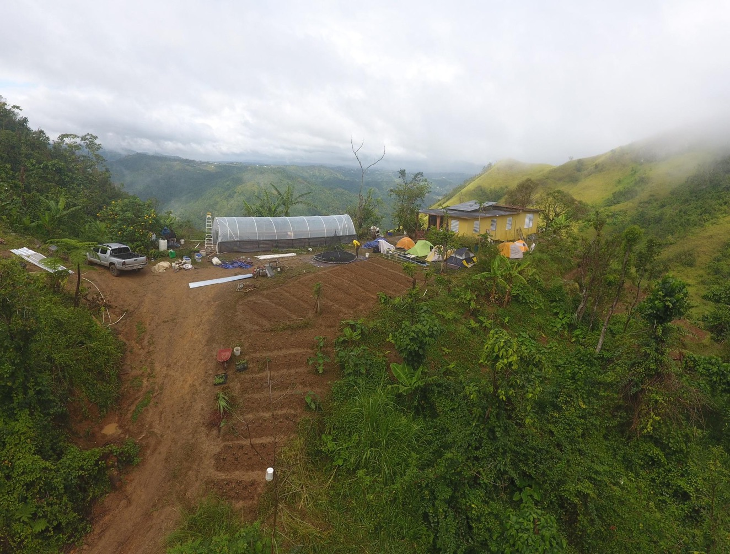
Finca La Jungla, Pellejas 1, Orocovis

Slide 27
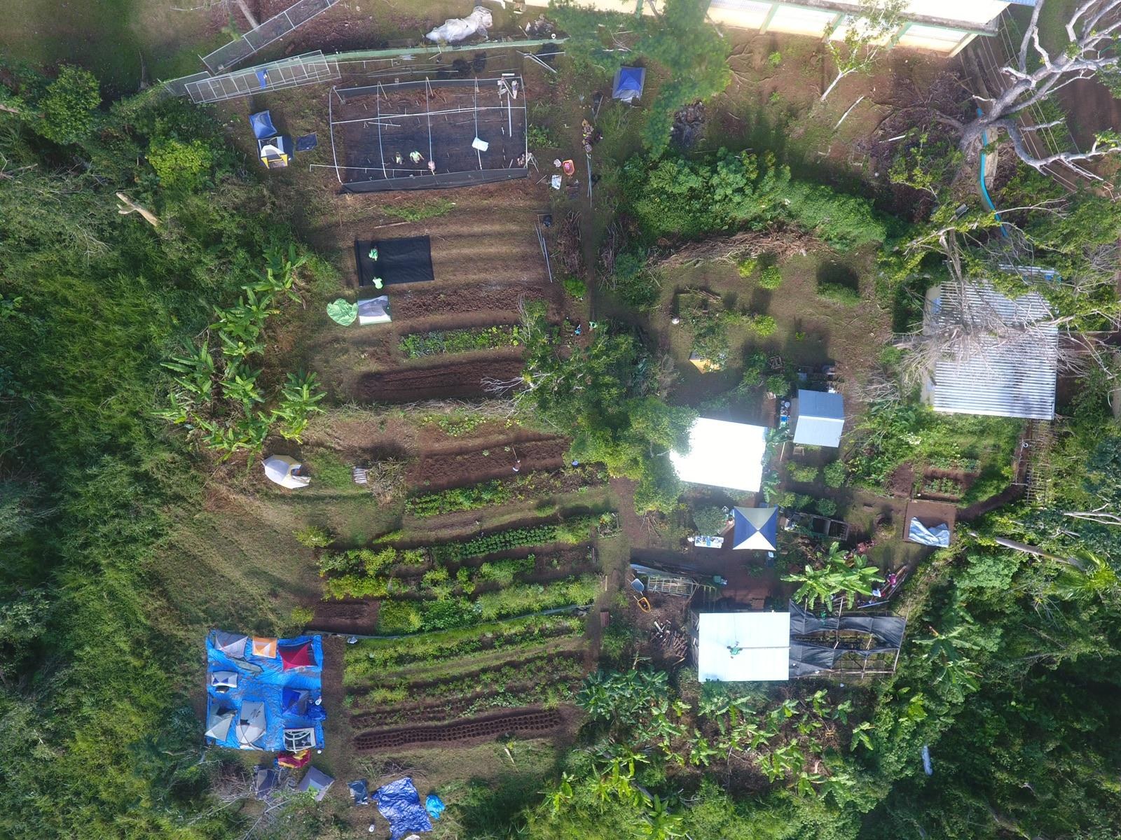
Proyecto Agricultura en Armonía con el Ambiente,
Escuela Segunda Unidad Botijas 1, Orocovis

Slide 28
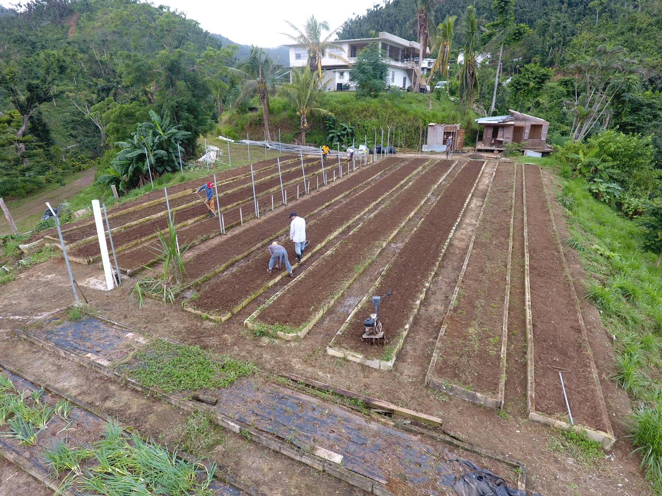
Finca 5 Elementos, Guadiana, Naranjito

Slide 29
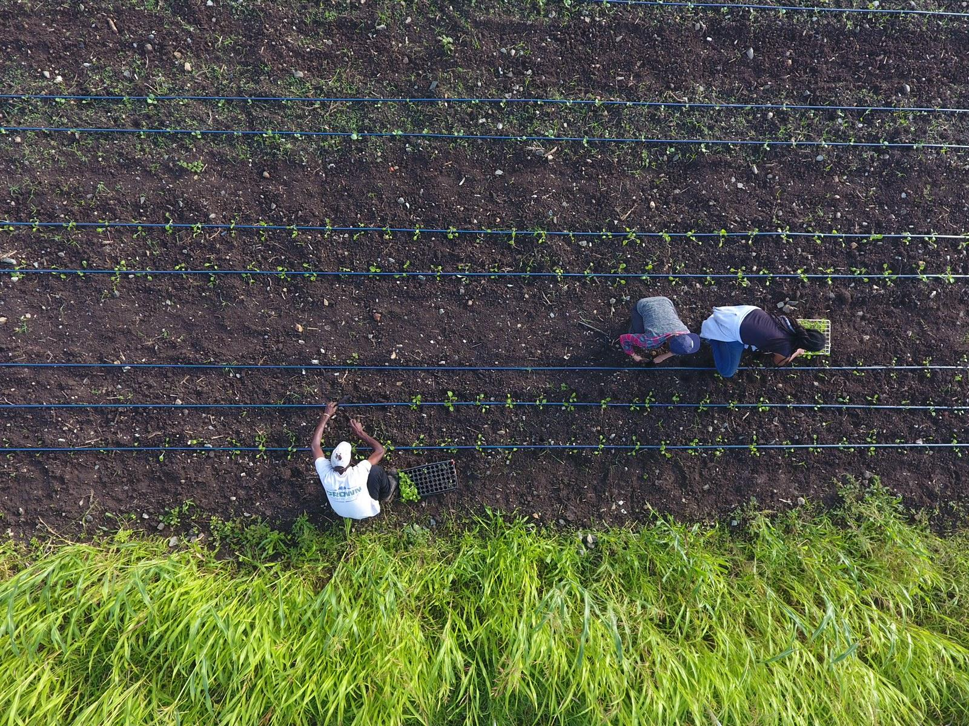
Sejah Farms, St. Croix, Virgin Islands

Slide 30
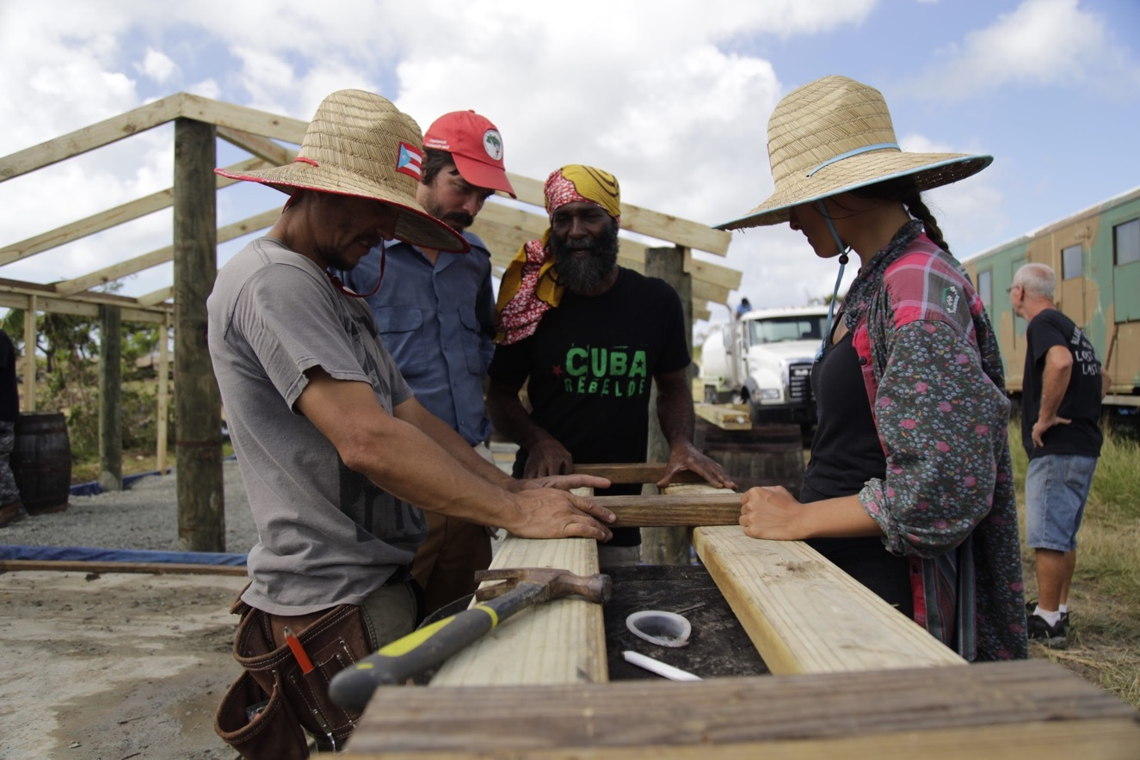
Sejah Farms, St. Croix, Virgin Islands

Slide 31
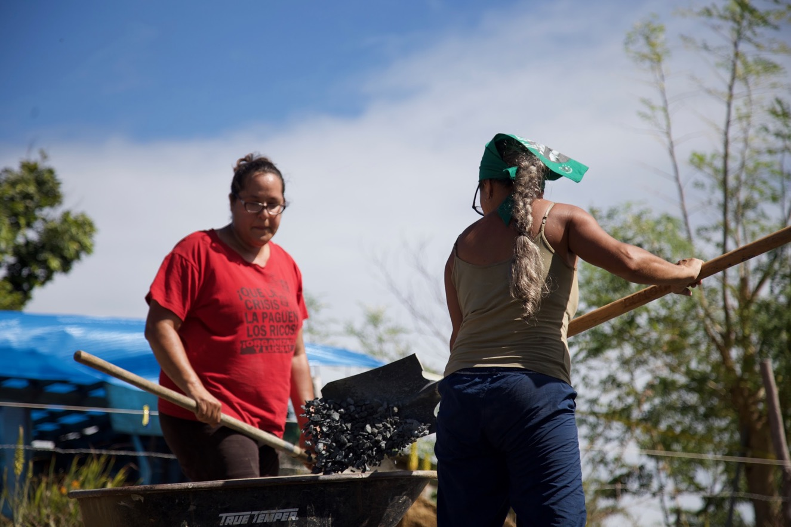
Finca Conciencia, Monte Carmelo, Vieques

Slide 32
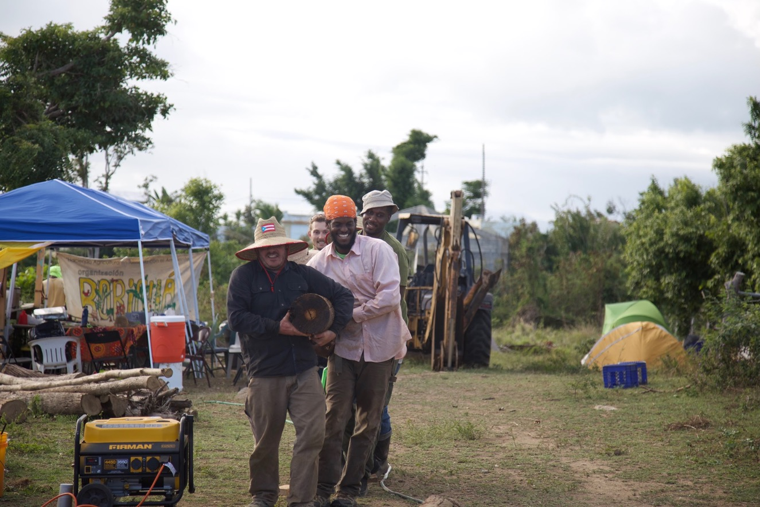
Finca Conciencia, Monte Carmelo, Vieques

Slide 33
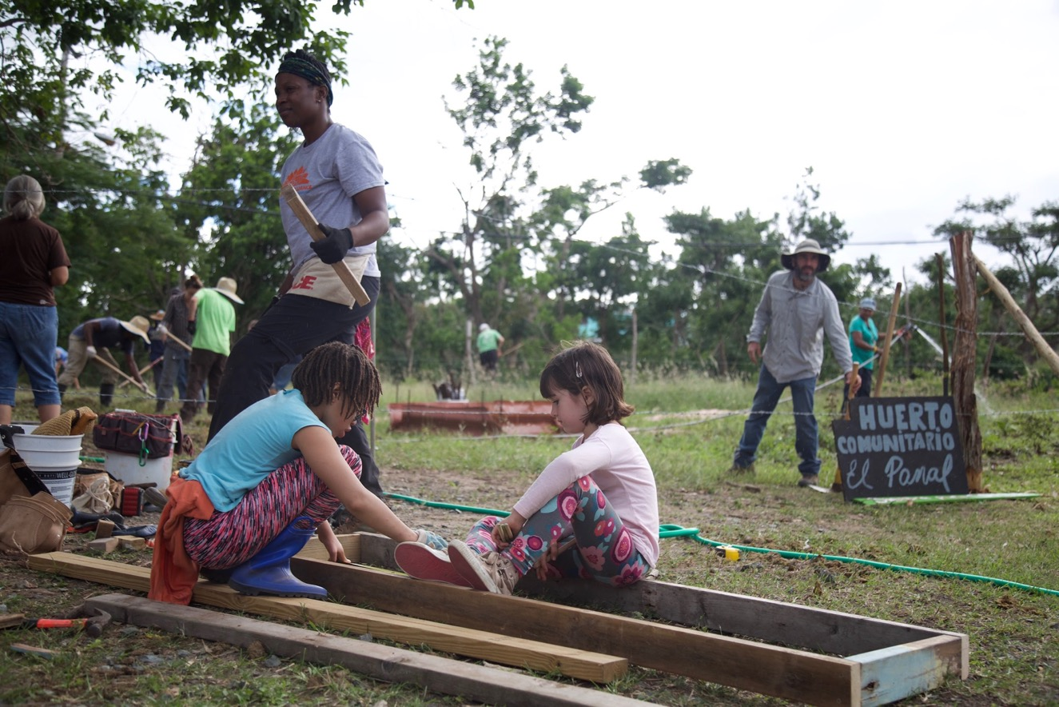
Huerto Comunitario El Panal, Vieques

Slide 34
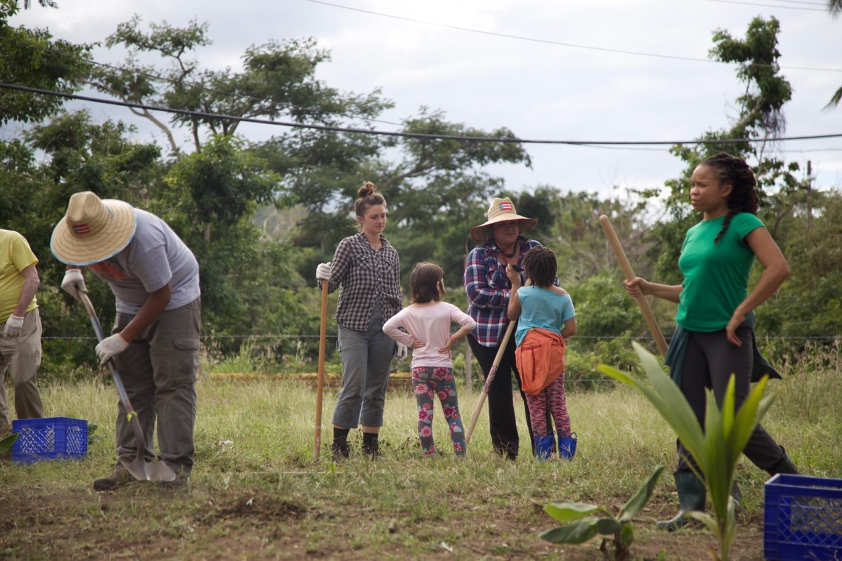
Huerto Comunitario El Panal, Vieques

Slide 35
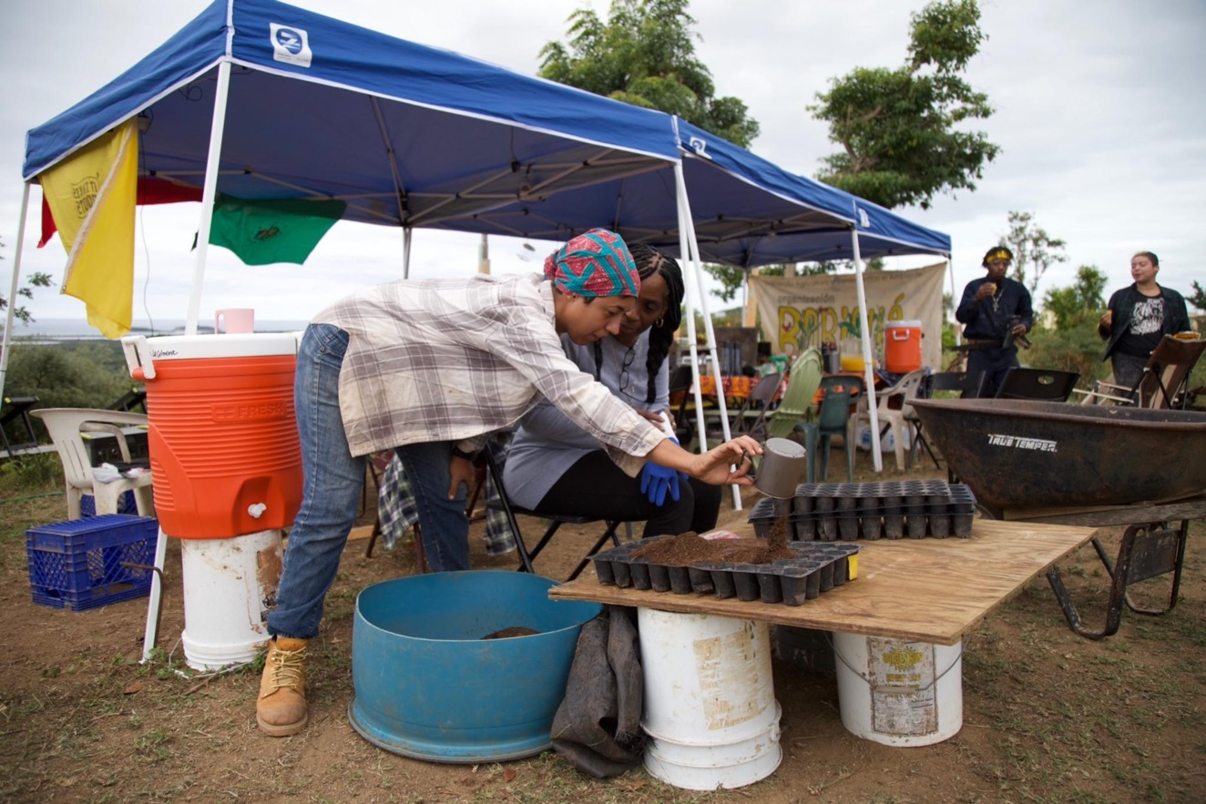
Finca Conciencia, Monte Carmelo, Vieques

Slide 36
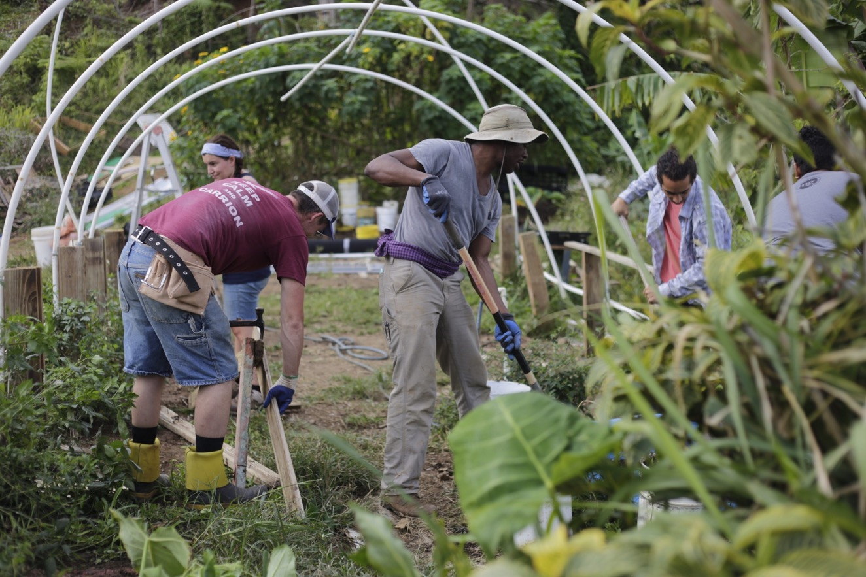
Finca La Jungla, Pellejas 1, Orocovis

Slide 37
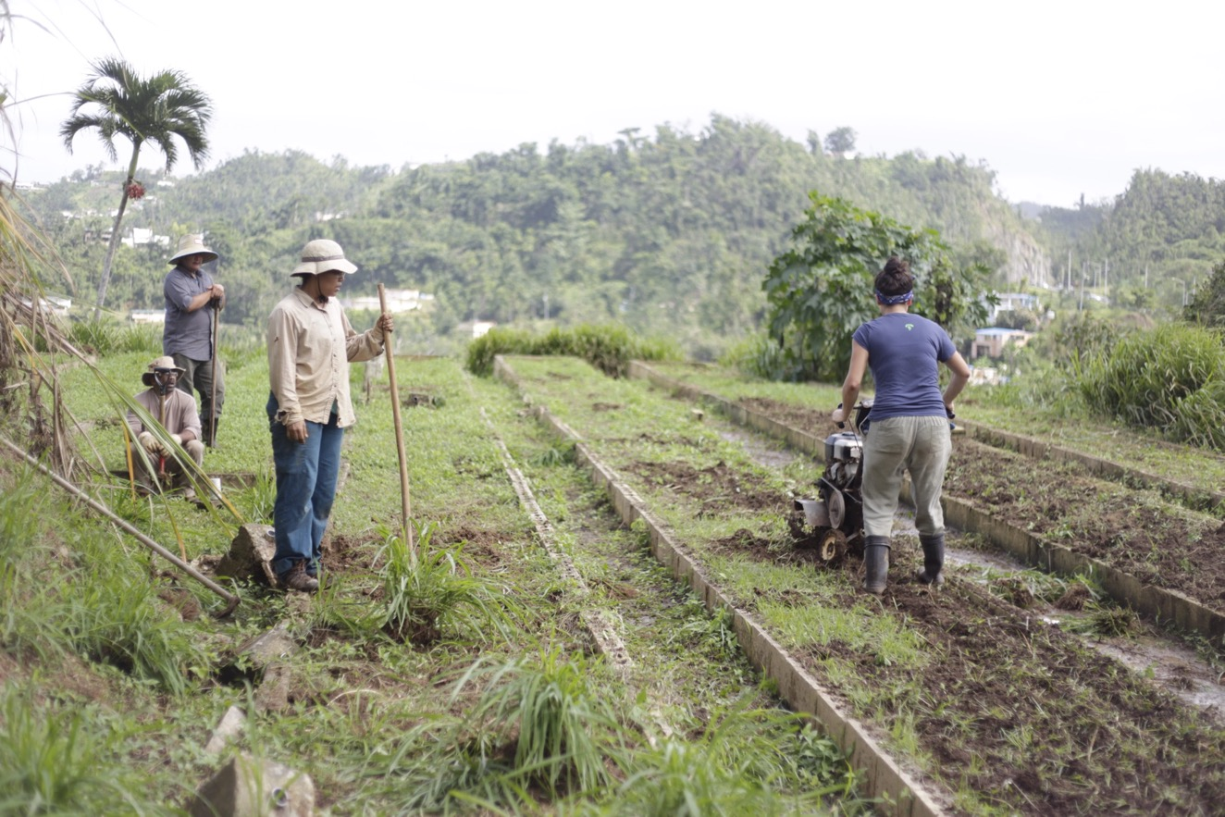
Finca 5 Elementos, Guadiana, Naranjito

Slide 38
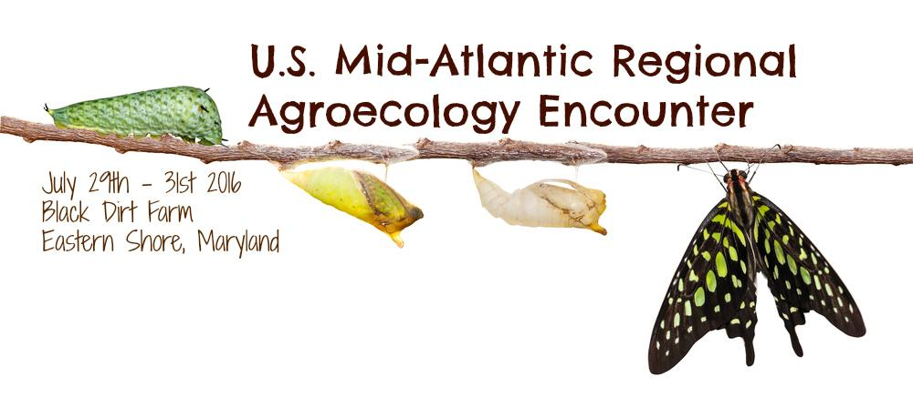
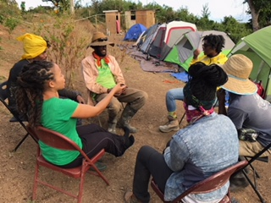
Black Dirt Farm Collective (BDFC)
Notes:
We are a group of mostly young Black agrarians who identify with the re-peasantization process of people returning to rural communities to live a life rooted in sustainable principles. We facilitate Agroecology encounters and brigades in the U.S. which we pull from the Campesino-a-campesino methodology or peasant to peasant process as horizontal knowledge exchanges.
That’s how we became connected to Boricua over 5 years ago and we’ve been engaging in deep learning together, sharing political space and cultural traditions since we met.
Our pre-existing relationships enabled us to form the political coordination team to plan the international solidarity brigade with less complications and more synergy. This laid the foundation for the solidarity processes to come.

Slide 39
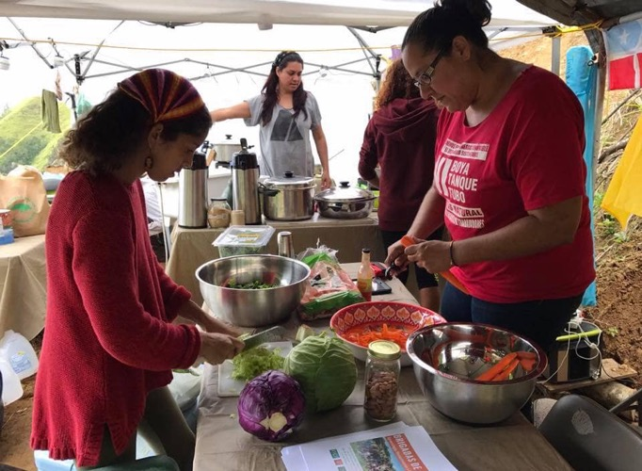
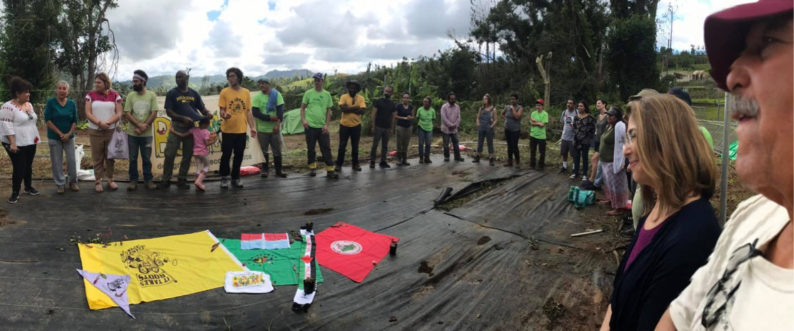
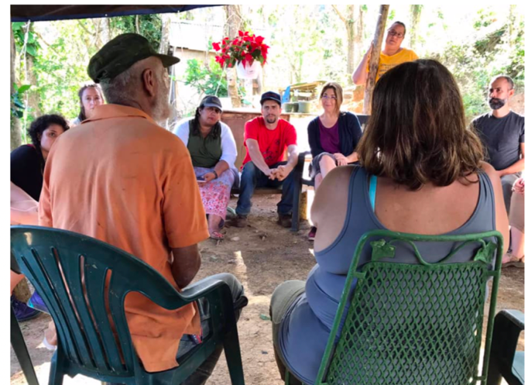
Solidarity Brigades As Meaningful Work
Notes:
I participated in the international solidarity brigade because building solidarity is part of building political power. And, in times of climate crisis and growing fascism, it’s important that we forefront meaningful work not only for societal transformation but for our very own transformation as spiritual beings in human form.
The brigade demonstrated how hard and important the work is and how our survival depends on us building relationships, trust and mutual accountability across geographies, cultures, histories and lived experiences. That’s what agroecology is… it’s not just about regenerative farming methods… the social, political and cultural formations that come out of the intentionality of how we relate to the land and each other holds it all together.

Slide 40
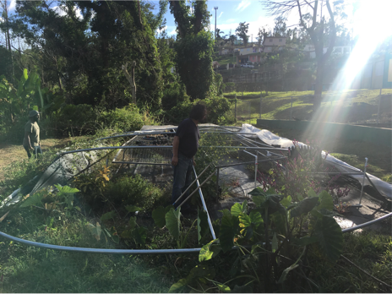
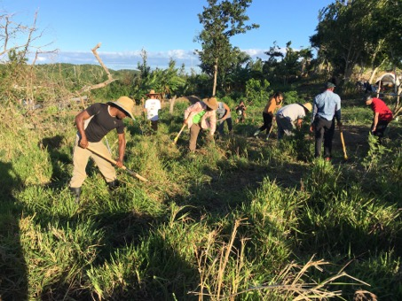
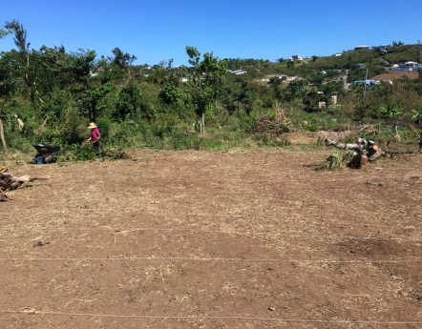
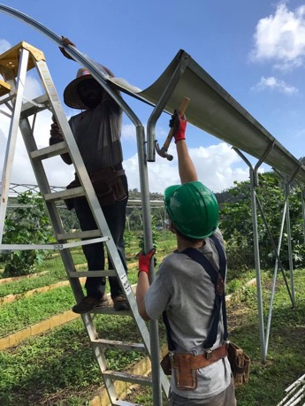
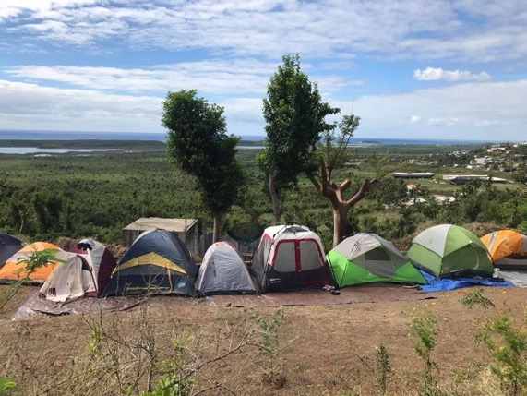
Farmer-to-Farmer Solidarity
Before
After
Before
After
Notes:
One of the most important ways we build solidarity is through doing meaningful work with each other that can be felt with the hands and heart. The brigade was such a phenomenal experience for everyone because we did everything together – cooked, cleaned, farmed, built physical structures and more.
As farmers and builders being in solidarity with one another, we were able to materially transform the landscape through collective work.
And, the collective work is organized around technical skill building, political consciousness raising, critical dialogue and shared reflection.

Slide 41
Geopolitical Exchanges
Notes:
As part of the technical piece, geopolitical learning and knowledge exchanges are important because place-based realities inform what and how knowledge is exchanged.
For example, rebuilding with recycled telephone poles is common tactic in the Caribbean and the Puerto Rican and St. Croix farmers were able to exchange specific tips such as how to position nails in the poles to be more resistant to hurricanes. As climate change continues to be central to farmers lives, especially in the Caribbean, how to drill nails in poles is a big deal. Now, the farmers are interested in organizing formación or trainings on Caribbean building after hurricanes in light of the pressing realities.

Slide 42
Reflection. Dialogue. Ceremony.
Notes:
As for the political piece, shared reflection and critical dialogue…
Reflection circles as safe spaces to share experiences and emotions with the group are essential.
Critical dialogues to work through interpersonal challenges were unexpectedly needed. Conversations around the race, gender and sexuality dynamics played a huge role in keeping the entire process afloat.
Ceremony as a way to spiritually ground us on the land was pivotal. Knowing the history of the land we were working on in solidarity with Boricua farmers was important because the land works on us as we work on it. The meaning we gather from the work heightens when we learn the history and stories of the land.
For example, Finca Conciencia, a a 6-acre diversied fruit and vegetable farm in Vieques, was named after Monte Carmelo an activist and beekeeper who strategically used bees to fight the land occupation of the U.S. military by positioning bees in concealed boxes to swarm when soldiers would come invade homes for land occupation and displacement.
Receiving these stories as part of the learning process is critical part of enacting food sovereignty because our technical skills are not as potent in absence of the cultural and political framing from where they come from.

Slide 43
Toward Food Sovereignty via Agroecological Solidarity Brigade Pedagogy
Meaningful work
Farmer-to-Farmer
Critical dialogue
Shared reflection
Ceremony
Horizontal communication
Participant preparation
Knowledge mapping
Notes:
To recap, the agroecological solidarity brigade pedagogy unfolded through the following…
And the last 2, I didn’t explain in detail but more information can be found in the report.

Slide 44
One Year of #OurPowerPRnyc

Slide 45
September 20th 2017
Maria makes landfall at Yabucoa Harbor as Category 4 Hurricane

Slide 46
September 29th 2017
UPROSE hosts night of conversation, healing, community building

Slide 47
October 11th 2017
Climate Justice Alliance and UPROSE launch OurPowerPR, stage National Day of Action

Slide 48
October-November 2017
UPROSE launches drive for relief supplies

Slide 49
October 16th 2017
Greenpeace's Arctic Sunrise ship arrives in Brooklyn to support OurPowerPR relief efforts

Slide 50
October-November 2017
UPROSE launches series of memes to elevate the crisis

Slide 51
November 1st 2017
UPROSE organizes Call To Action meeting to unite the diaspora.
#OurPowerPRnyc is born.

Slide 52
November 1st 2017
#OurPowerPRnyc establishes platform guided by Jemez Principles of Democratic Organizing:
Drop the Debt
Repeal the Jones Act
Show Solidarity & Support
Say NO to The Puerto Rico Oversight, Management, and Economic Stability Act
Push for a Just Recovery & Transition
Support Puerto Rican Climate Refugees
Reject the "Tax Cuts and Jobs Act"

Slide 53
December 29th 2017
#OurPowerPRnyc holds 100 Days Since Maria action

Slide 54
January 2018
#OurPowerPRnyc launches memes targeting PROMESA

Slide 55
January 22nd 2018
#OurPowerPRnyc gathers to confront members of the Fiscal Control Board at a "Rebuilding Puerto Rico" panel discussion

Slide 56
Winter-Spring 2018
OurPowerPR launches five Solidarity Brigades in Puerto Rico to support "Just Recovery and Rebuild" projects

Slide 57
Spring 2018
#OurPowerPRnyc keeps the memes coming

Slide 58
June 10th 2018
#OurPowerPRnyc forms contingent in National Puerto Rican Day Parade under theme "El poder lo tenemos nosotros"

Slide 59
June 19th 2018
#OurPowerPRnyc holds a community forum on Vieques with grassroots leaders for conversation on
leadership, resilience, sovereignty

Slide 60
September 20th 2018
#OurPowerPRnyc holds gathering to mark one year since Maria

Slide 61
Questions
Access the report online:
https://bit.ly/2YNpAfT
Contact us
info@climateadvocacylab.org • holly@climatejusticealliance.org
Offer your feedback!
https://forms.gle/ixKymYcwT9NjGxUH7
Image: Screen-printed posters created on the Greenpeace boat. Photo by Crystal Clarity.

Slide 62
Thank you!
Access the report online:
https://bit.ly/2YNpAfT
Contact us
info@climateadvocacylab.org holly@climatejusticealliance.org
Image: Organización Boricuá members sowing fields in a community farm.

